Slide 1
A BIBLICAL PRESCRIPTION FOR RENEWED STRENGTH
Isaiah 40:28–31
Pastor Roderick Webster
West Indies Baptist Fellowship Conference 2026
Fort Lauderdale, Florida

Slide 2
Isaiah 40:28(KJV)
²⁸Hast thou not known? hast thou not heard, that the everlasting God, the LORD, the Creator of the ends of the earth, fainteth not, neither is weary? there is no searching of his understanding.

Slide 3
Isaiah 40:29(KJV)
²⁹He giveth power to the faint; and to them that have no might he increaseth strength.

Slide 4
Isaiah 40:30(KJV)
³⁰Even the youths shall faint and be weary, and the young men shall utterly fall:

Slide 5
Isaiah 40:31(KJV)
³¹But they that wait upon the LORD shall renew their strength; they shall mount up with wings as eagles; they shall run, and not be weary; and they shall walk, and not faint.

Slide 6
A BIBLICAL PRESCRIPTION FOR RENEWED STRENGTH
Isaiah 40:28–31
Pastor Roderick Webster
West Indies Baptist Fellowship Conference 2026
Fort Lauderdale, Florida

Slide 7
Isaiah 40:29(KJV)
²⁹He giveth power to the faint; and to them that have no might he increaseth strength.

Slide 8
Isaiah 40:30(KJV)
³⁰Even the youths shall faint and be weary, and the young men shall utterly fall:

Slide 9
A BIBLICAL PRESCRIPTION FOR RENEWED STRENGTH
Isaiah 40:28–31
Pastor Roderick Webster
West Indies Baptist Fellowship Conference 2026
Fort Lauderdale, Florida

Slide 10
Isaiah 40:28(KJV)
²⁸Hast thou not known? hast thou not heard, that the everlasting God, the LORD, the Creator of the ends of the earth, fainteth not, neither is weary? there is no searching of his understanding.

Slide 11
A BIBLICAL PRESCRIPTION FOR RENEWED STRENGTH
Isaiah 40:28–31
Pastor Roderick Webster
West Indies Baptist Fellowship Conference 2026
Fort Lauderdale, Florida

Slide 12
Hosea 4:6(KJV)
⁶My people are destroyed for lack of knowledge: because thou hast rejected knowledge, I will also reject thee, that thou shalt be no priest to me: seeing thou hast forgotten the law of thy God, I will also forget thy children.

Slide 13
A BIBLICAL PRESCRIPTION FOR RENEWED STRENGTH
Isaiah 40:28–31
Pastor Roderick Webster
West Indies Baptist Fellowship Conference 2026
Fort Lauderdale, Florida

Slide 14
Matthew 22:29(KJV)
²⁹Jesus answered and said unto them, Ye do err, not knowing the scriptures, nor the power of God.

Slide 15
A BIBLICAL PRESCRIPTION FOR RENEWED STRENGTH
Isaiah 40:28–31
Pastor Roderick Webster
West Indies Baptist Fellowship Conference 2026
Fort Lauderdale, Florida

Slide 16
Isaiah 40:29(KJV)
²⁹He giveth power to the faint; and to them that have no might he increaseth strength.

Slide 17
A BIBLICAL PRESCRIPTION FOR RENEWED STRENGTH
Isaiah 40:28–31
Pastor Roderick Webster
West Indies Baptist Fellowship Conference 2026
Fort Lauderdale, Florida

Slide 18
Isaiah 40:31(KJV)
³¹But they that wait upon the LORD shall renew their strength; they shall mount up with wings as eagles; they shall run, and not be weary; and they shall walk, and not faint.

Slide 19
A BIBLICAL PRESCRIPTION FOR RENEWED STRENGTH
Isaiah 40:28–31
Pastor Roderick Webster
West Indies Baptist Fellowship Conference 2026
Fort Lauderdale, Florida

Slide 20
Psalms 62:1(KJV)
¹Truly my soul waiteth upon God: from him cometh my salvation.

Slide 21
A BIBLICAL PRESCRIPTION FOR RENEWED STRENGTH
Isaiah 40:28–31
Pastor Roderick Webster
West Indies Baptist Fellowship Conference 2026
Fort Lauderdale, Florida

Slide 22
Proverbs 8:34(KJV)
³⁴Blessed is the man that heareth me, watching daily at my gates, waiting at the posts of my doors.

Slide 23
A BIBLICAL PRESCRIPTION FOR RENEWED STRENGTH
Isaiah 40:28–31
Pastor Roderick Webster
West Indies Baptist Fellowship Conference 2026
Fort Lauderdale, Florida

Slide 24
A BIBLICAL PRESCRIPTION FOR RENEWED STRENGTH
POINT I
We Will Have Renewed Strength

Slide 25
Isaiah 40:31(KJV)
³¹But they that wait upon the LORD shall renew their strength; they shall mount up with wings as eagles; they shall run, and not be weary; and they shall walk, and not faint.

Slide 26
A BIBLICAL PRESCRIPTION FOR RENEWED STRENGTH
POINT I
We Will Have Renewed Strength

Slide 27
2 Corinthians 12:9(KJV)
⁹And he said unto me, My grace is sufficient for thee: for my strength is made perfect in weakness. Most gladly therefore will I rather glory in my infirmities, that the power of Christ may rest upon me.

Slide 28
A BIBLICAL PRESCRIPTION FOR RENEWED STRENGTH
POINT I
We Will Have Renewed Strength

Slide 29
1 Corinthians 16:13(KJV)
¹³Watch ye, stand fast in the faith, quit you like men, be strong.

Slide 30
A BIBLICAL PRESCRIPTION FOR RENEWED STRENGTH
POINT I
We Will Have Renewed Strength

Slide 31
Daniel 1:8(KJV)
⁸But Daniel purposed in his heart that he would not defile himself with the portion of the king's meat, nor with the wine which he drank: therefore he requested of the prince of the eunuchs that he might not defile himself.

Slide 32
A BIBLICAL PRESCRIPTION FOR RENEWED STRENGTH
POINT I
We Will Have Renewed Strength

Slide 33
2 Corinthians 4:16(KJV)
¹⁶For which cause we faint not; but though our outward man perish, yet the inward man is renewed day by day.

Slide 34
A BIBLICAL PRESCRIPTION FOR RENEWED STRENGTH
POINT I
We Will Have Renewed Strength

Slide 35
Ephesians 3:16(KJV)
¹⁶That he would grant you, according to the riches of his glory, to be strengthened with might by his Spirit in the inner man;

Slide 36
A BIBLICAL PRESCRIPTION FOR RENEWED STRENGTH
POINT I
We Will Have Renewed Strength

Slide 37
Proverbs 24:16(KJV)
¹⁶For a just man falleth seven times, and riseth up again: but the wicked shall fall into mischief.

Slide 38
A BIBLICAL PRESCRIPTION FOR RENEWED STRENGTH
POINT I
We Will Have Renewed Strength

Slide 39
Isaiah 40:31(KJV)
³¹But they that wait upon the LORD shall renew their strength; they shall mount up with wings as eagles; they shall run, and not be weary; and they shall walk, and not faint.

Slide 40
A BIBLICAL PRESCRIPTION FOR RENEWED STRENGTH
POINT I
We Will Have Renewed Strength

Slide 41
Psalms 119:28(KJV)
²⁸My soul melteth for heaviness: strengthen thou me according unto thy word.

Slide 42
A BIBLICAL PRESCRIPTION FOR RENEWED STRENGTH
POINT I
We Will Have Renewed Strength

Slide 43
Luke 22:43(KJV)
⁴³And there appeared an angel unto him from heaven, strengthening him.

Slide 44
A BIBLICAL PRESCRIPTION FOR RENEWED STRENGTH
POINT I
We Will Have Renewed Strength

Slide 45
Acts 2:42(KJV)
⁴²And they continued stedfastly in the apostles' doctrine and fellowship, and in breaking of bread, and in prayers.

Slide 46
A BIBLICAL PRESCRIPTION FOR RENEWED STRENGTH
POINT I
We Will Have Renewed Strength

Slide 47
Ephesians 6:10(KJV)
¹⁰Finally, my brethren, be strong in the Lord, and in the power of his might.

Slide 48
Ephesians 6:11(KJV)
¹¹Put on the whole armour of God, that ye may be able to stand against the wiles of the devil.

Slide 49
A BIBLICAL PRESCRIPTION FOR RENEWED STRENGTH
POINT I
We Will Have Renewed Strength

Slide 50
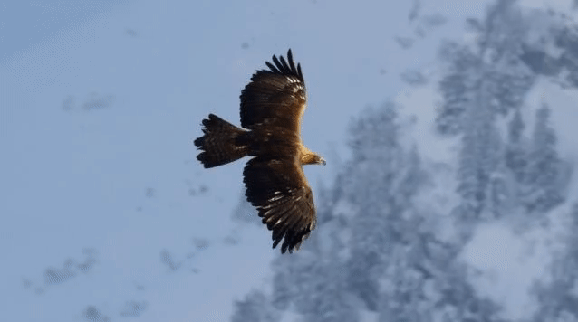
A BIBLICAL PRESCRIPTION FOR RENEWED STRENGTH
POINT II
We will soar on wings
like eagles.

Slide 51
A BIBLICAL PRESCRIPTION FOR RENEWED STRENGTH
POINT III
We Will Do Supernatural Things

Slide 52
John 7:38(KJV)
³⁸He that believeth on me, as the scripture hath said, out of his belly shall flow rivers of living water.

Slide 53
John 14:12(KJV)
¹²Verily, verily, I say unto you, He that believeth on me, the works that I do shall he do also; and greater works than these shall he do; because I go unto my Father.

Slide 54
A BIBLICAL PRESCRIPTION FOR RENEWED STRENGTH
POINT III
We Will Do Supernatural Things

Slide 55
Isaiah 40:29(KJV)
²⁹He giveth power to the faint; and to them that have no might he increaseth strength.

Slide 56
A BIBLICAL PRESCRIPTION FOR RENEWED STRENGTH
POINT III
We Will Do Supernatural Things

Slide 57
Galatians 5:25(KJV)
²⁵If we live in the Spirit, let us also walk in the Spirit.

Slide 58
Genesis 5:24(KJV)
²⁴And Enoch walked with God: and he was not; for God took him.

Slide 59
Psalms 119:28(KJV)
²⁸My soul melteth for heaviness: strengthen thou me according unto thy word.

Slide 60
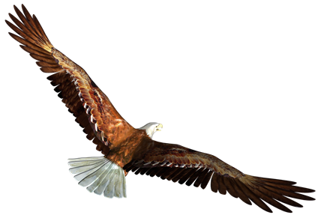

Wait on the Lord!
He will renew your strength.

